Slide 1
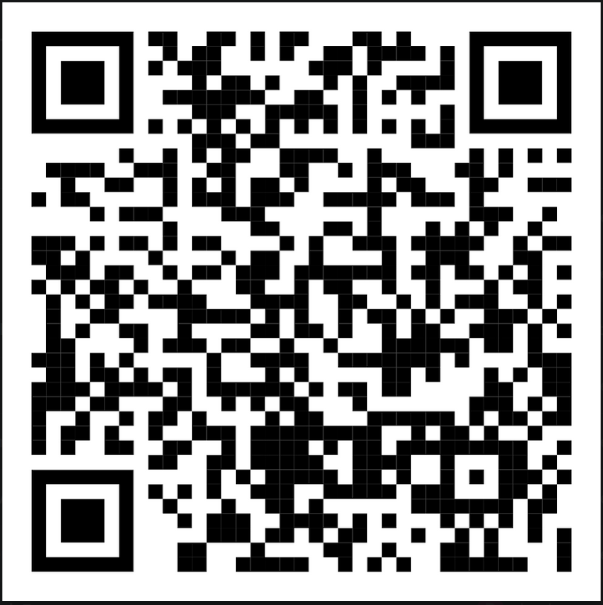
Attendance

Slide 2
Introduction to Python Programming
Joshua Ganschow
DSU Computer Club

Slide 3
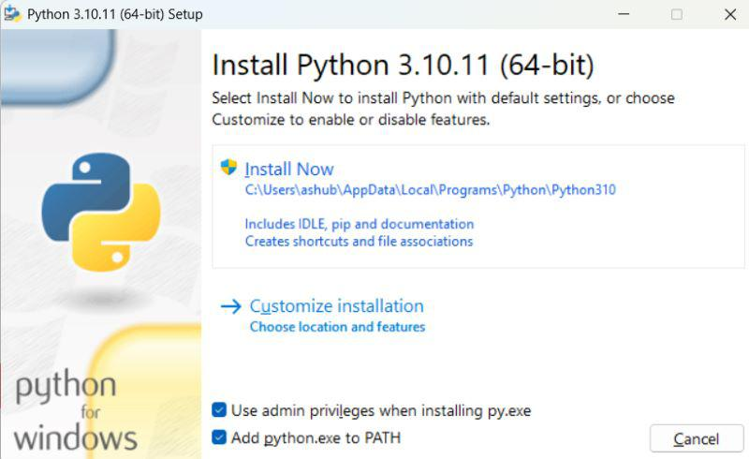
First, We Need to Install
Go to www.python.org/downloads
Run the downloaded exe
You can choose to install for all users or not, but the important thing is to make sure that the option ‘Add python.exe to PATH’ is selected. This will allow you to run python through your command line
If you’re okay with installing to the default location, click ‘Install Now’ after selecting the previously-mentioned checkbox

Slide 4

Installing
Once that is done installing, verify that Python has been installed by opening a new command prompt window and typing the following command:

Slide 5
What is Python?
Python is a high-level, interpreted language made for readability and simplicity of syntax.
Key features:
Readable
Easy to learn
Interpreted and dynamically typed
Supports multiple programming paradigms
Procedural
Object-Oriented
Functional
Vast standard library for various applications

Slide 6
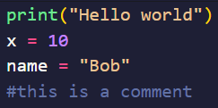
Python Basics
Python uses indentation for code blocks rather than braces
Basic structure

Slide 7
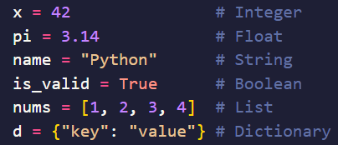
Data Types and Variables
Common data types:
Numbers: int, float
Strings: str
Booleans: bool
Lists: list
Dictionaries: dict

Slide 8
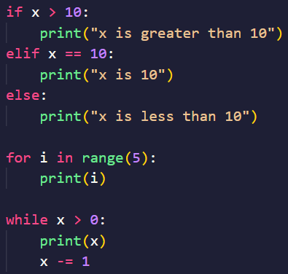
Control Structures
Conditionals (if, elif, else)
Loops (for, while)

Slide 9
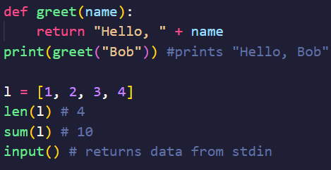
Functions
Defining functions: def keyword
Builtin Functions:
len(iter) returns the length of an iterable
sum(iter) returns the sum of an iterable
input() returns string input from the user from stdin

Slide 10

Working with Libraries
Libraries contain pre-written code that you can import and use
Popular libraries:
math
random
pandas
Python’s flexibility shins when you start importing and using external libraries

Slide 11
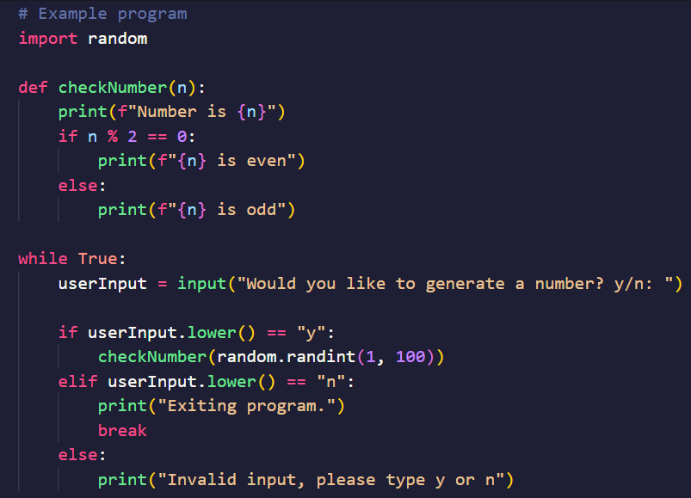
Example Program

Slide 12
Questions?

